Slide 1


Introduction to Docker
Infra Class : 21 August 2019
Heronimus Tresy <heronimus.tresy@gdn-commerce.com>

Slide 2
IT Landscape is Changing ..

Slide 3
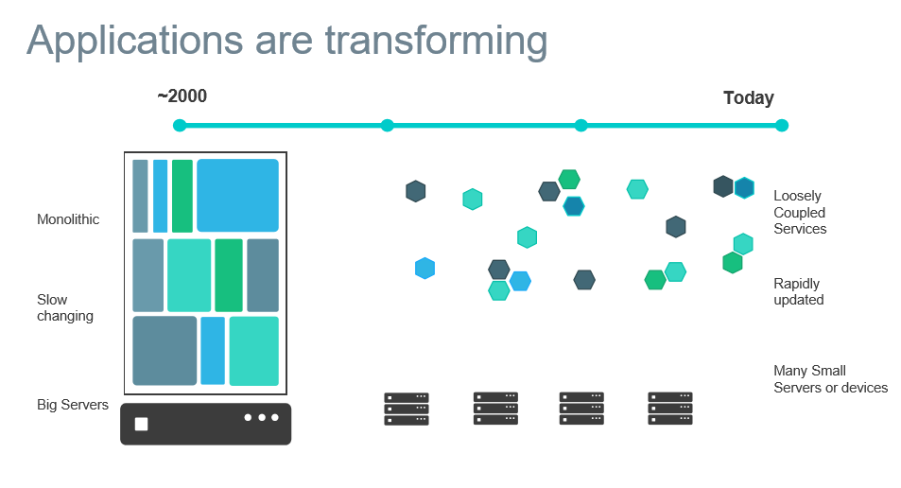
https://www.slideshare.net/Docker/introduction-to-docker-2017

Slide 4
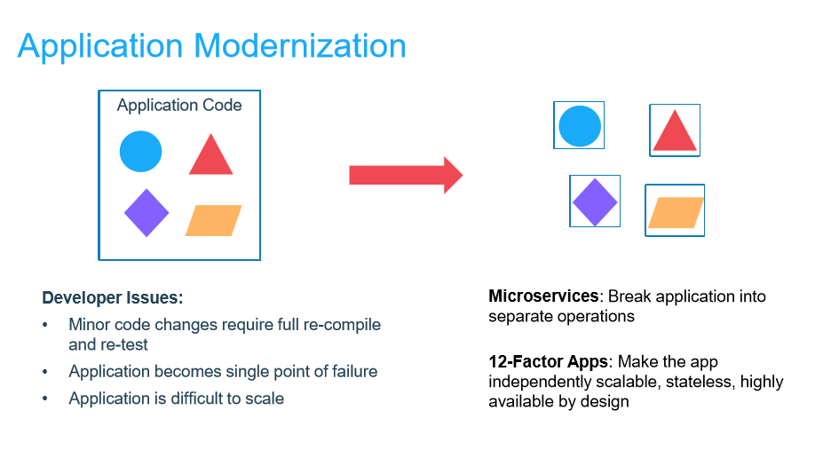
https://www.slideshare.net/Docker/introduction-to-docker-2017

Slide 5
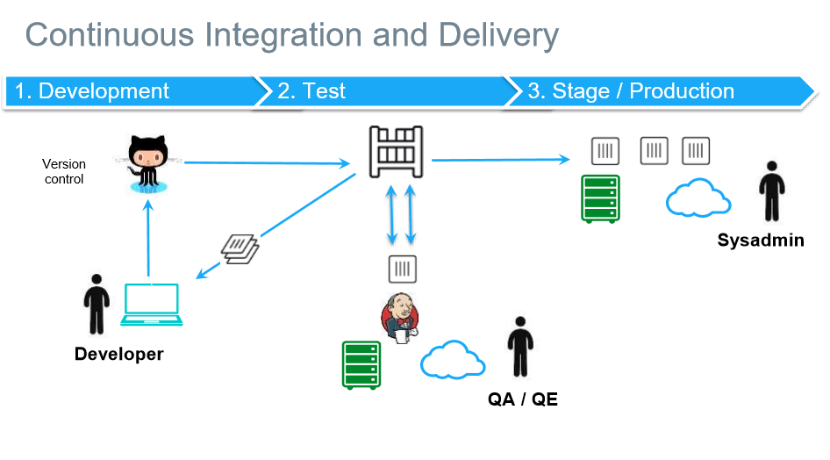
https://www.slideshare.net/Docker/introduction-to-docker-2017

Slide 6
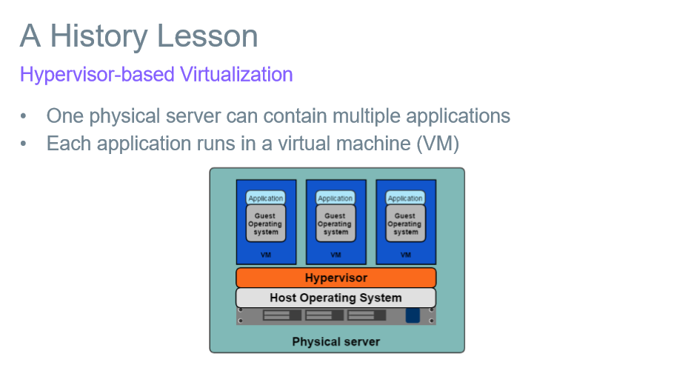
https://www.slideshare.net/Docker/introduction-to-docker-2017

Slide 7
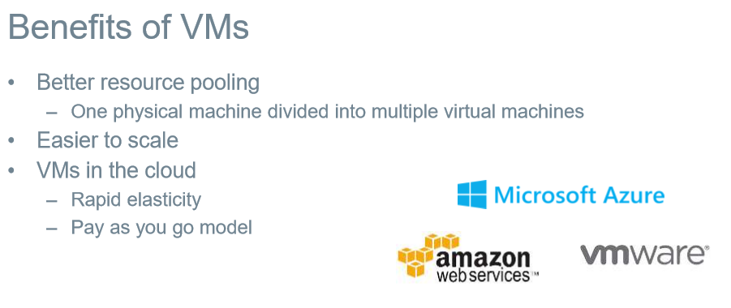
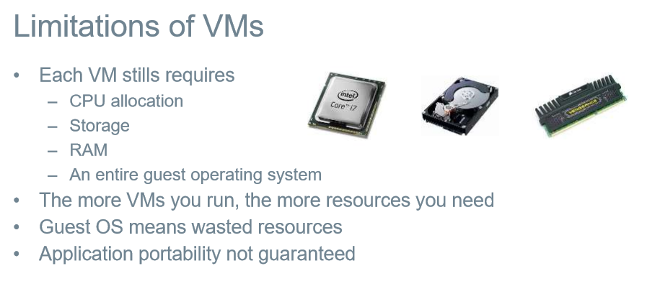
https://www.slideshare.net/Docker/introduction-to-docker-2017

Slide 8
Docker Overview ..

Slide 9
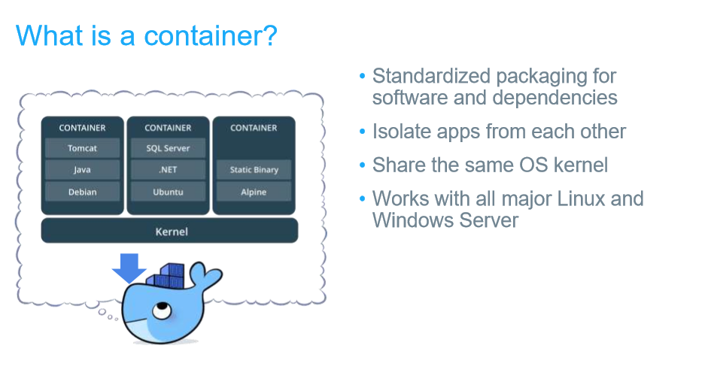
https://docs.docker.com/get-started/
https://www.slideshare.net/Docker/introduction-to-docker-2017

Slide 10
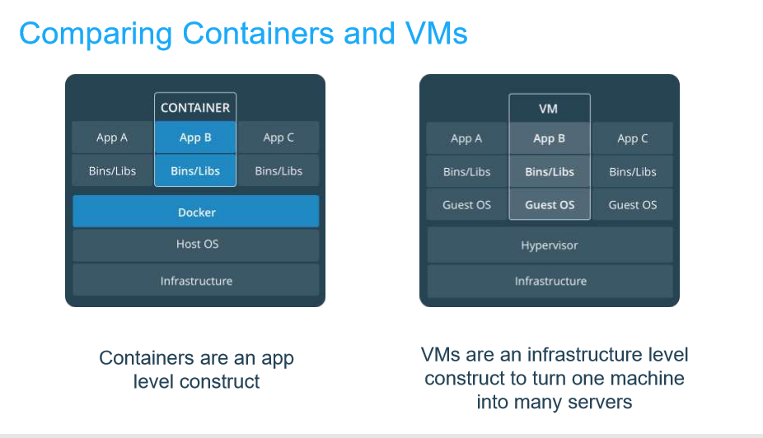
https://docs.docker.com/get-started/
https://www.slideshare.net/Docker/introduction-to-docker-2017

Slide 11
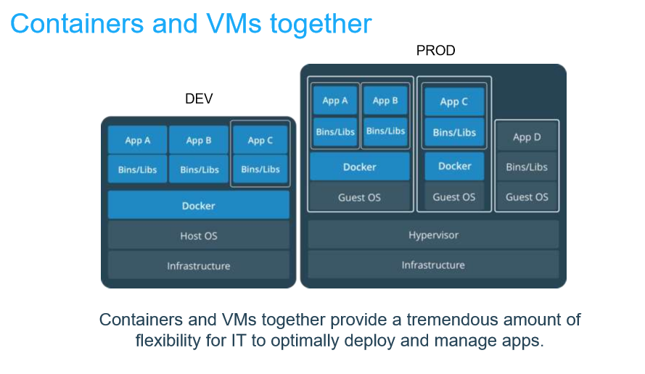
https://docs.docker.com/get-started/
https://www.slideshare.net/Docker/introduction-to-docker-2017

Slide 12
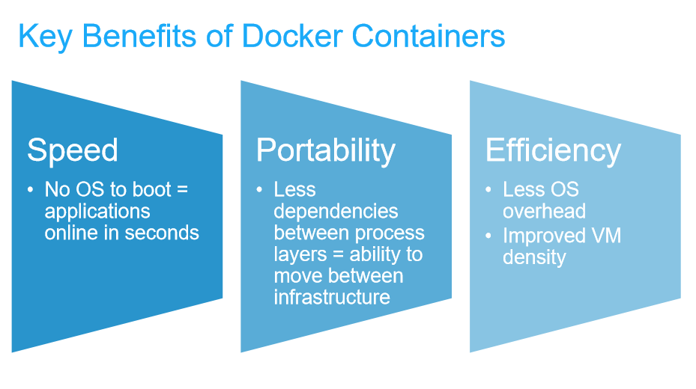
+ scability
+ isolation + security

Slide 13
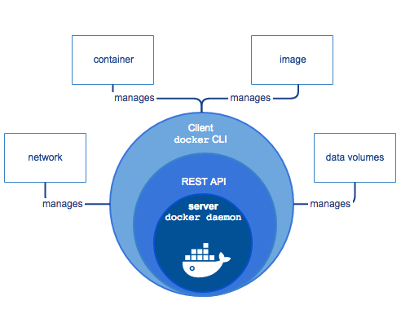
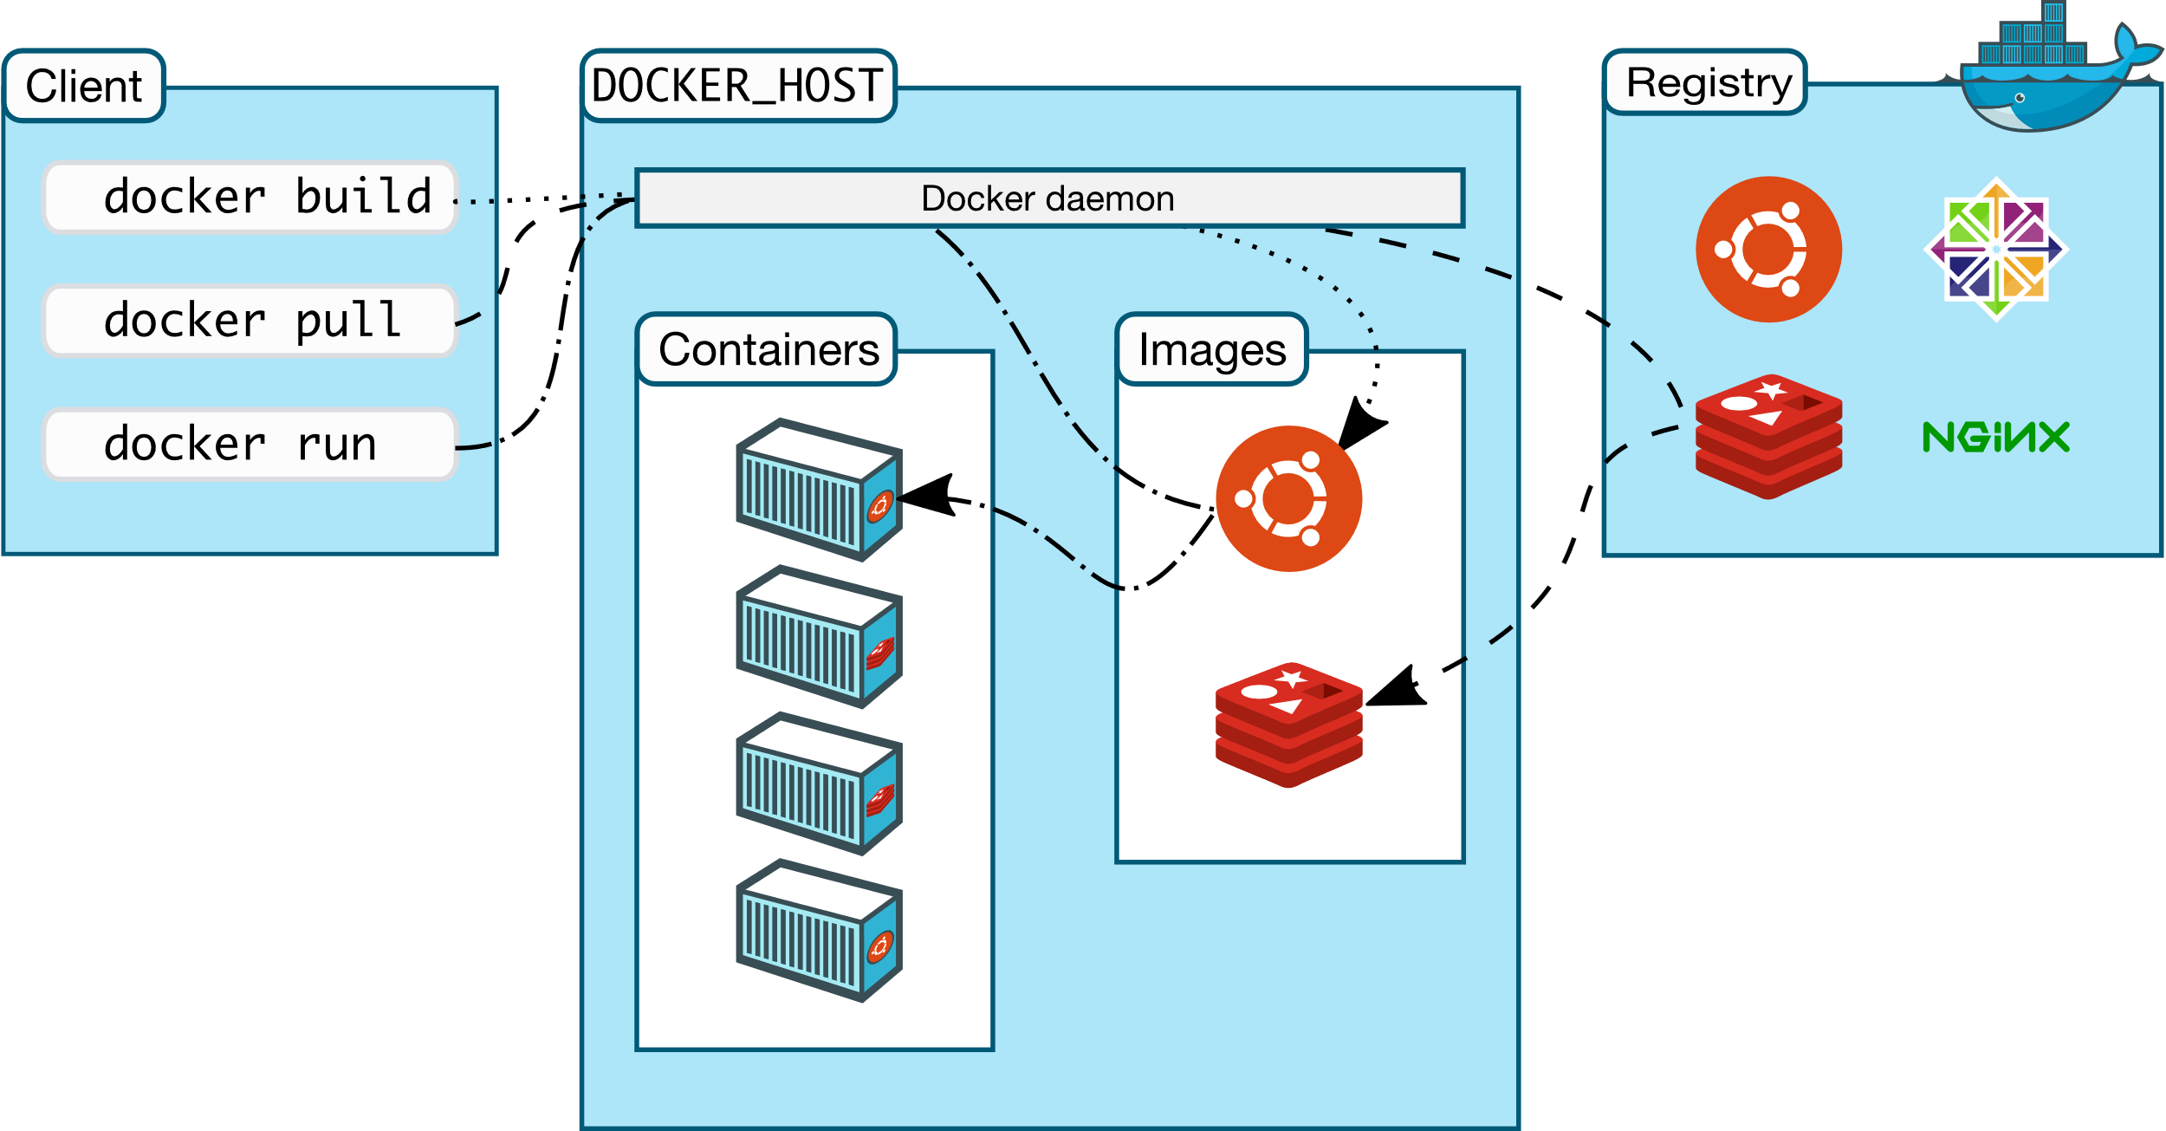
Docker Component Flow
https://docs.docker.com/engine/docker-overview/

Slide 14
Inside Docker ..

Slide 15
Docker-CLI
https://docs.docker.com/engine/reference/commandline/docker/
Example:
>> docker image
>> docker container
>> docker stats
….……
>> docker run image:tag
>> docker run –d –p8000:5000 –-name container-name image:tag
>> docker exec –it <container name> /bin/bash
…………

Slide 16
Docker File
FROM debian:stable-slim
ENV name John Doe
ENTRYPOINT ["/bin/bash", "-c", "echo Hello, $name"]
FROM openjdk:14-jdk-alpine3.10
RUN mkdir -p /opt/myapp
WORKDIR /opt/myapp
COPY . .
ENV JAVA_OPTS="-Xms128m -Xmx256m"
CMD ["java", "-jar","springboot-futureprogram-web.jar"]
FROM alpine:latest
ENTRYPOINT ["/bin/echo", "Hello"]
CMD ["World"]
>> docker build -t imagename:tag
>> docker run imagename:tag
https://docs.docker.com/develop/develop-images/dockerfile_best-practices/

Slide 17
Other Useful Link
https://goinbigdata.com/docker-run-vs-cmd-vs-entrypoint/
https://github.com/CentOS/CentOS-Dockerfiles
Docker Registry
https://docs.docker.com/registry/
https://docs.docker.com/docker-hub/
https://cloud.docker.com
>> docker tag <image id> username/name:tag
>> docker push username/name:tag

Slide 18
------------------------------------------------------------------------
version: '3.3'
services:
dbsql:
image: mysql:5.7
volumes:
- db_data:/var/lib/mysql
replicas: 3
restart: always
environment:
MYSQL_ROOT_PASSWORD: somewordpress
MYSQL_DATABASE: wordpress
MYSQL_USER: wordpress
MYSQL_PASSWORD: wordpress
wordpress:
depends_on:
- db
image: wordpress:latest
ports:
- "8000:80"
restart: always
environment:
WORDPRESS_DB_HOST: dbsql:3306
WORDPRESS_DB_USER: wordpress
WORDPRESS_DB_PASSWORD: wordpress
WORDPRESS_DB_NAME: wordpress
volumes:
db_data: {}
------------------------------------------------------------------------
docker-compose
https://docs.docker.com/compose/
>> docker-compose up
Try this !
https://docs.docker.com/compose/gettingstarted/

Slide 19
Docker Orchestration Overview ...

Slide 20
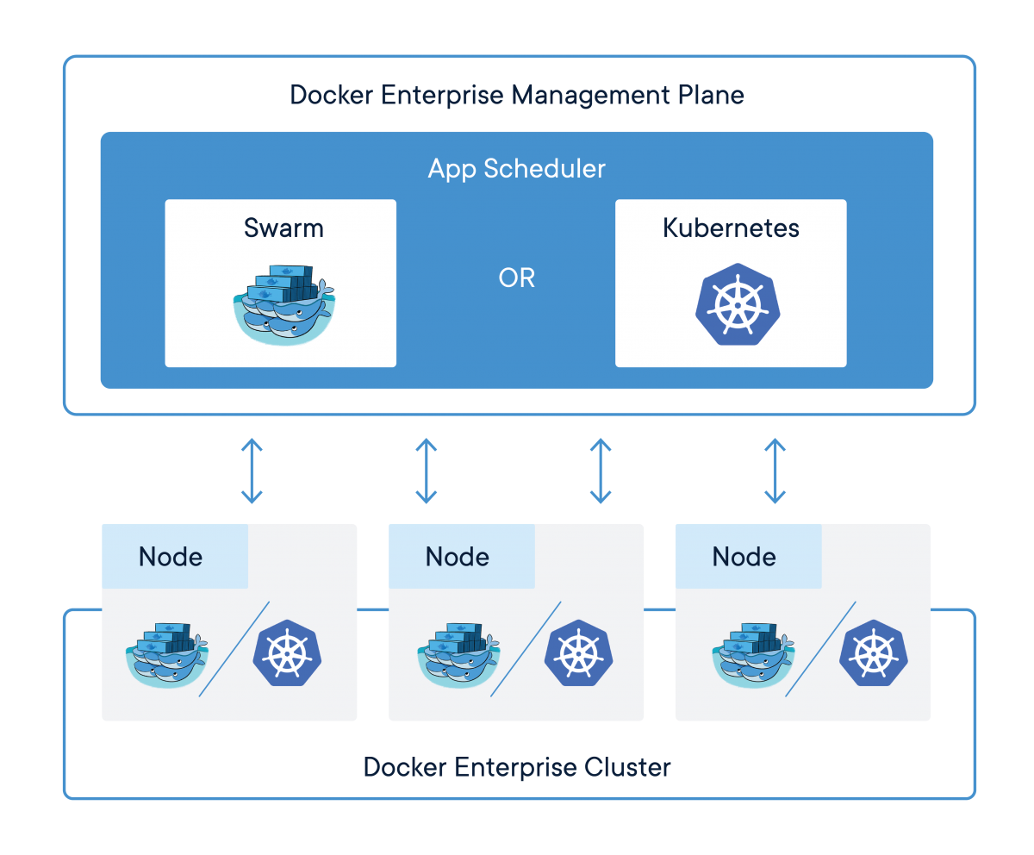
Docker Orchestration
https://www.docker.com/products/orchestration
Docker Swarm
https://docs.docker.com/engine/swarm/
https://docs.docker.com/engine/swarm/raft/
>> docker swarm init
>> docker swarm join
>> docker stack deploy –c docker-compose.yml
>> docker service
……..
Kubernetes
Later on ….

Slide 21
Exercise: Create Swarm
Using docker-machine:
>> docker-machine create --driver virtualbox swarm-vm1
>> docker-machine create --driver virtualbox swarm-vm2
>> docker-machine create --driver virtualbox swarm-vm3
>> docker-machine ls
>> docker-machine ssh swarm-vm1 "docker swarm init --advertise-addr 192.168.99.100“
>> docker-machine ssh swarm-vm2 "docker swarm join …. "
>> docker-machine ssh swarm-vm3 "docker swarm join …. "
>> docker node ls
……..
More Resource : https://www.callicoder.com/docker-machine-swarm-stack-golang-example/

Slide 22
Try to Containerized Your Apps ...

